Slide 1
Clause Size Reduction with all-UIP Learning
Nick Feng and Fahiem Bacchus
University of Toronto

Slide 2
Introduction

Slide 3
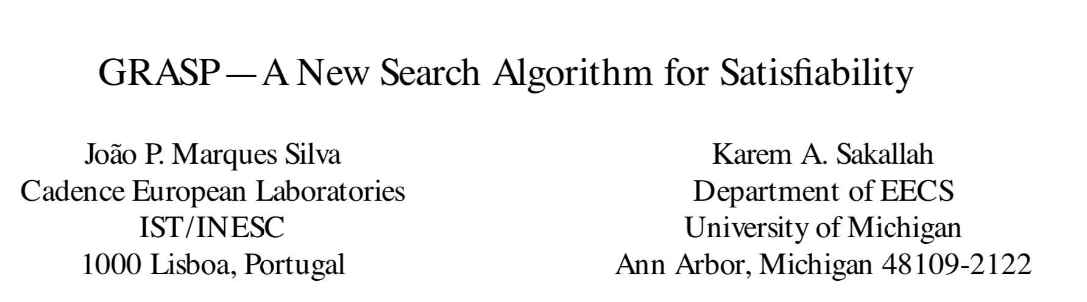
Clause Learning
Clause Learning is an essential technique in SAT solvers (1996)

Slide 4

Clause Learning
Clause Learning is an essential technique in SAT solvers (1996)
Many learning schemes proposed, but converged on 1-UIP after Chaff’s success (2001)

Slide 5

Clause Learning
Clause Learning is an essential technique in SAT solvers (1996)
Many learning schemes proposed, but converged on 1-UIP after Chaff’s success (2001)
LBD (Literal Block Distance) proposed as clause quality metric (2009)

Slide 6
Clause Learning
Clause Learning is an essential technique in SAT solvers (1996)
Many learning schemes proposed, but converged on 1-UIP after Chaff’s success (2001)
LBD (Literal Block Distance) proposed as clause quality metric (2009)
1-UIP clauses have the optimal LBD among all clauses from UIP schemes

Slide 7
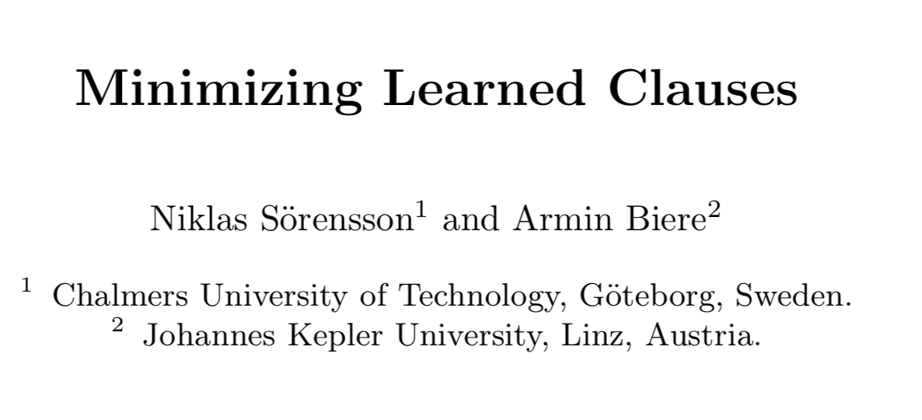
Clause Learning
Clause Learning is an essential technique in SAT solvers (1996)
Many learning schemes proposed, but converged on 1-UIP after Chaff’s success (2001)
LBD (Literal Block Distance) proposed as clause quality metric (2009)
1-UIP clauses have the optimal LBD among all clauses from UIP schemes
However, 1-UIP clauses can be large, and need minimization (2009)

Slide 8
Clause Learning
Clause Learning is an essential technique in SAT solvers (1996)
Many learning schemes proposed, but converged on 1-UIP after Chaff’s success (2001)
LBD (Literal Block Distance) proposed as clause quality metric (2009)
1-UIP clauses have the optimal LBD among all clauses from UIP schemes
However, 1-UIP clauses can be large, and need minimizations (2009)
Investigation of Chaff's 1-UIP scheme came before our knowledge of LBD and techniques for clause minimization

Slide 9
Our Goals:
Re-examine 1-UIP and other early proposed alternatives
Design a new learning scheme by exploiting the main idea of all-UIP learning
Provide Empirical evidences for the new scheme

Slide 10

Re-examine Existing Learning Schemes

Slide 11
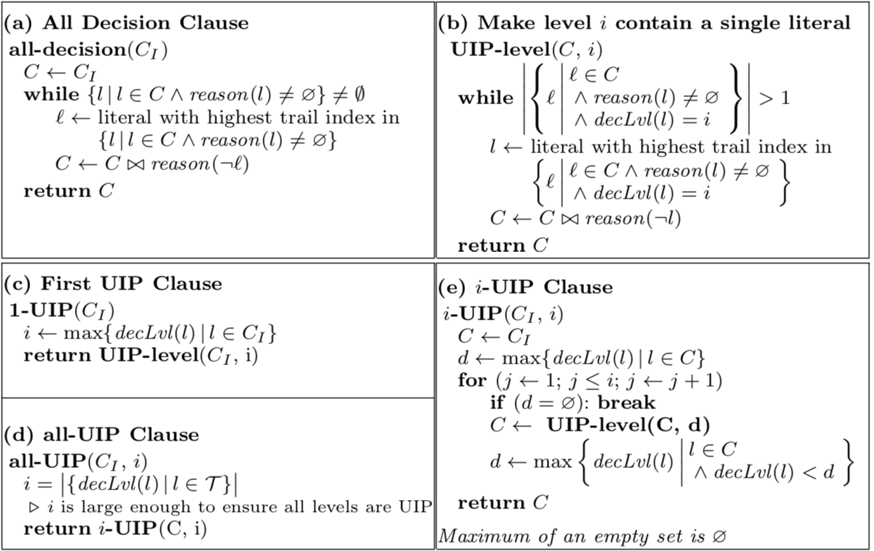
Learning Schemes
Decision for
all levels
UIP for the
deepest level
UIP for the
first i levels
UIP for all
levels

Slide 12
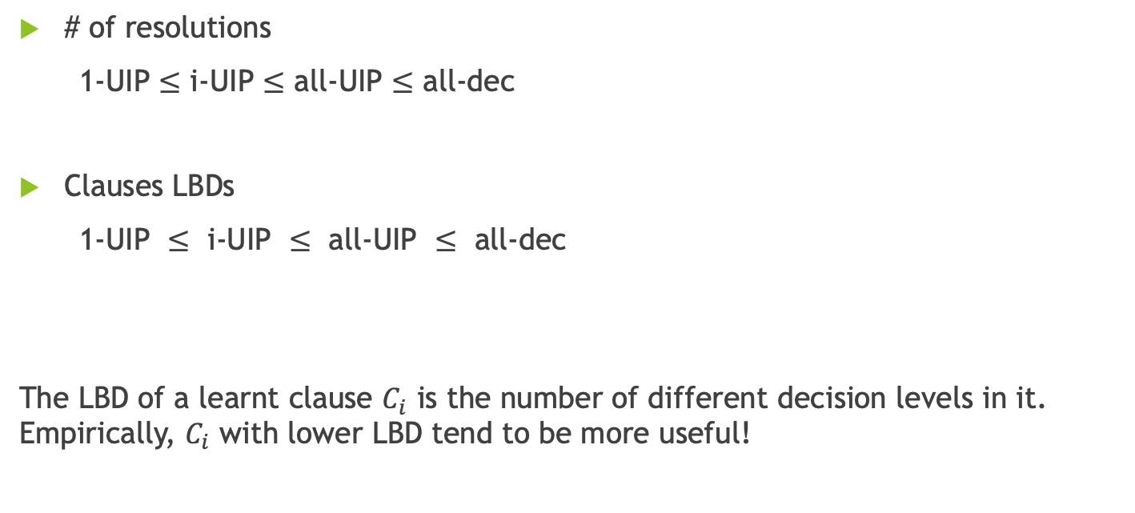
Schemes Comparison
# of resolutions
1-UIP $≤$ i-UIP $≤$ all-UIP $≤$ all-dec
Clauses LBDs
$\text{1-}\text{UIP} ≤ \text{i}\text{-}\text{UIP} ≤ \text{all}\text{-}\text{UIP} ≤ \text{all}\text{-}\text{dec}$
The LBD of a learnt clause $C_{i}$ is the number of different decision levels in it. Empirically, $C_{i}$ with lower LBD tend to be more useful!

Slide 13
Reasons to Prefer 1-UIP
1-UIP clauses are asserting (1-empowering)
They have the optimal LBD among all asserting clauses
Less learning overhead (resolution step)

Slide 14
Alternative Learning Schemes
i-UIP, all-UIP and all-dec learning schemes:
Have larger LBD
Have more learning overhead
However, the extra resolutions performed by them may reduce the clause size significantly over the 1-UIP clause
learning scheme recipe:
(1) 1-empowering
(2) the minimum LBD
(3) small clause size (our focus)

Slide 15

Using all-UIP Clause Learning

Slide 16
Why Learn Shorter Clause
Although LBD is the more important quality metric, learning shorter clause is important because:
Less memory
Smaller future clauses
Semantically stronger
We exploit all-UIP learning scheme for its ability to learn shorter clauses.
stable-alluip

Slide 17

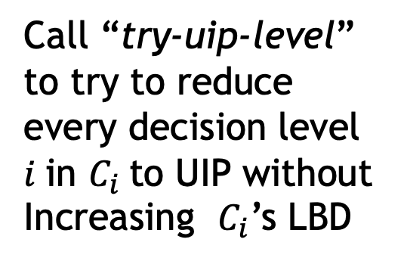
stable-alluip Clause Learner
Minimized 1-UIP clause
Call “try-uip-level”
to try to reduce every decision level $i$in $C_{i}$to UIP without Increasing $C_{i}$’s LBD
Return the shorter clause between $C_{i}$ and $C_{1}$ after

Slide 18
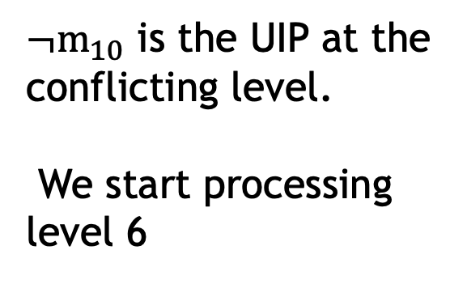
$¬m_{10}$ is the UIP at the conflicting level.
We start processing level 6

Slide 19
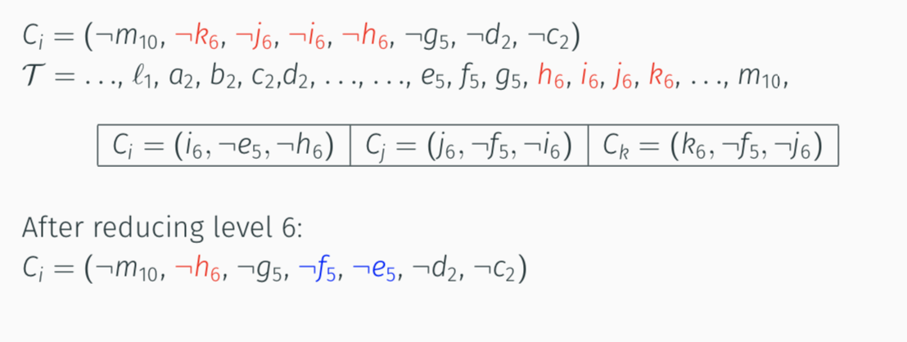
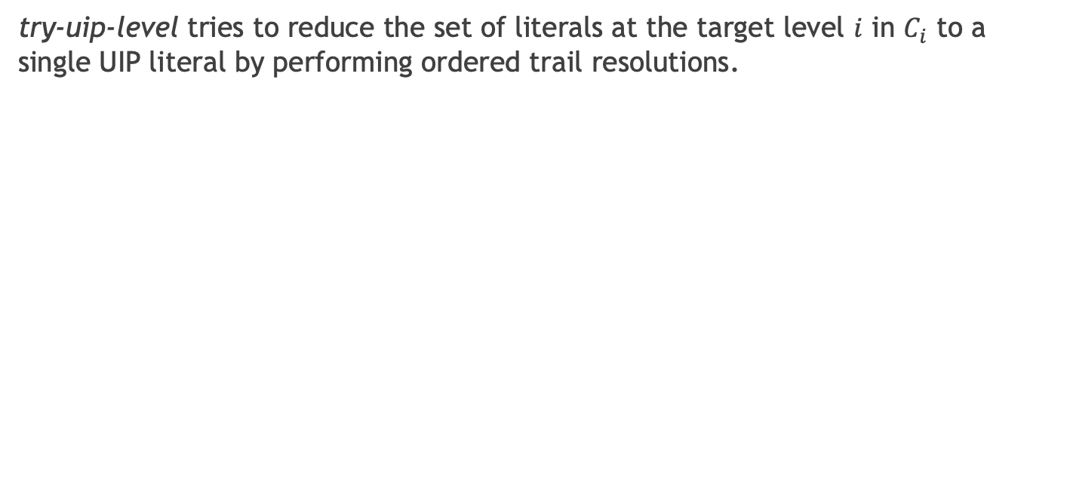
Try-uip-level 6
try-uip-level tries to reduce the set of literals at the target level $i$ in $C_{i}$ to a single UIP literal by performing ordered trail resolutions.

Slide 21
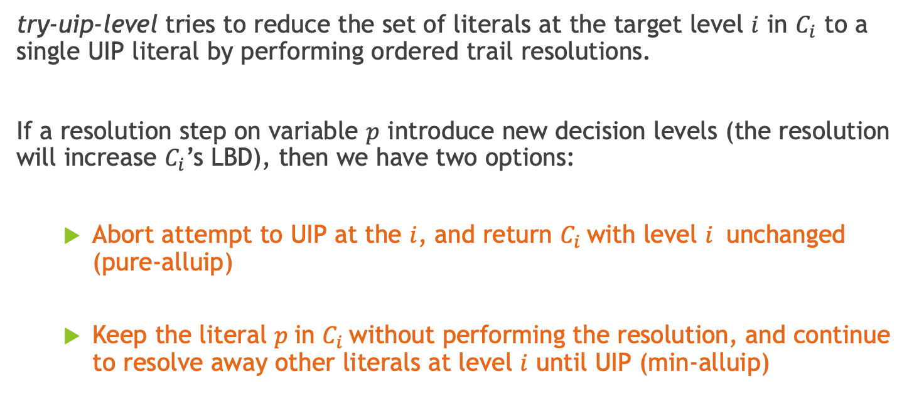
Try-uip-level 5
try-uip-level tries to reduce the set of literals at the target level $i$ in $C_{i}$ to a single UIP literal by performing ordered trail resolutions.
If a resolution step on variable $p$ introduce new decision levels (the resolution will increase $C_{i}$’s LBD), then we have two options:
Abort attempt to UIP at the $i$, and return $C_{i}$with level $i$ unchanged (pure-alluip)
Keep the literal $p$in $C_{i}$without performing the resolution, and continue to resolve away other literals at level $i$ until UIP (min-alluip)

Slide 22
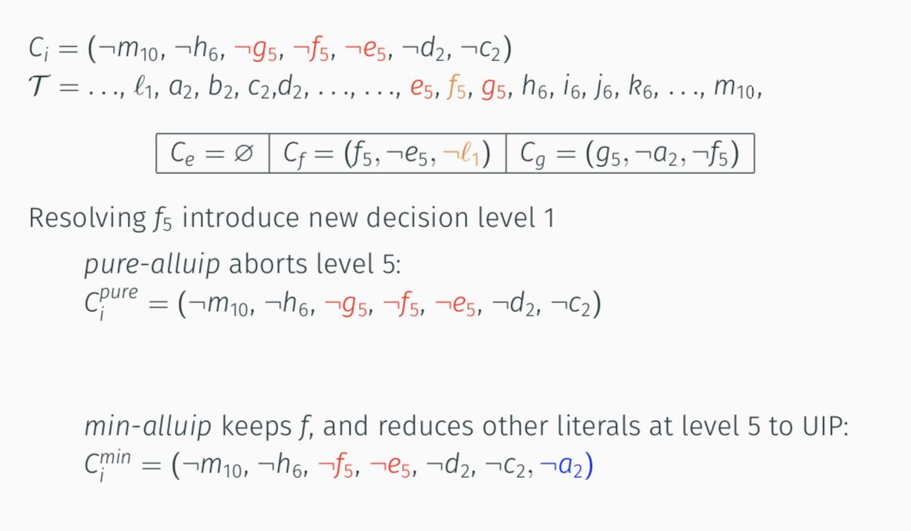
Try-uip-level 5
unchanged

Slide 23
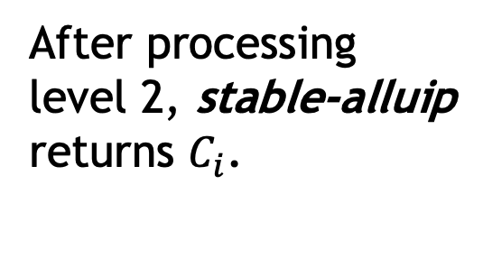
After processing level 2, stable-alluip returns $C_{i}$.
Size Reduction 1
Size Reduction 2

Slide 24
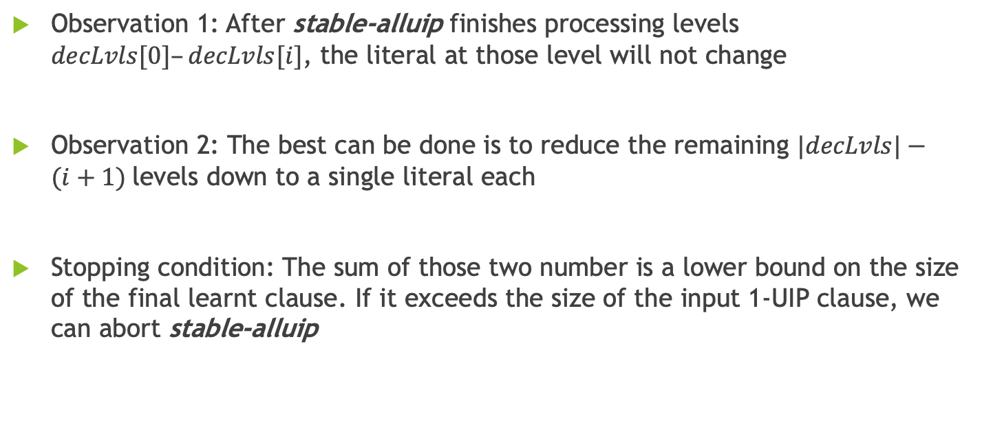
Optimization 1: Early Stop
Observation 1: After stable-alluip finishes processing levels $decLvls[0]–decLvls[i]$, the literal at those level will not change
Observation 2: The best can be done is to reduce the remaining $|decLvls|−(i+1)$levels down to a single literal each
Stopping condition: The sum of those two number is a lower bound on the size of the final learnt clause. If it exceeds the size of the input 1-UIP clause, we can abort stable-alluip

Slide 25
Early stop: Check the stopping condition here

Slide 26
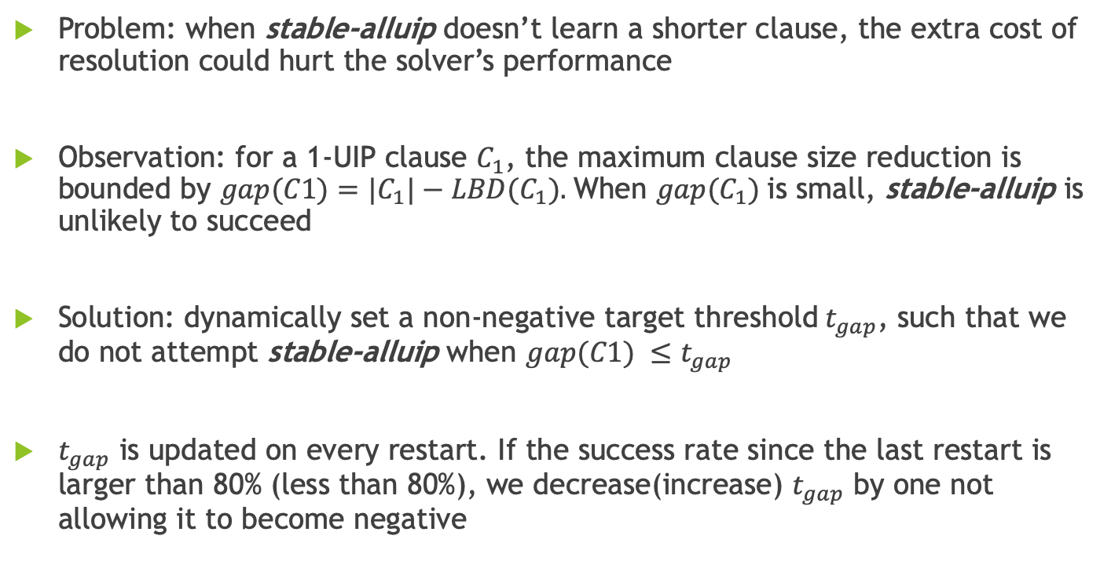
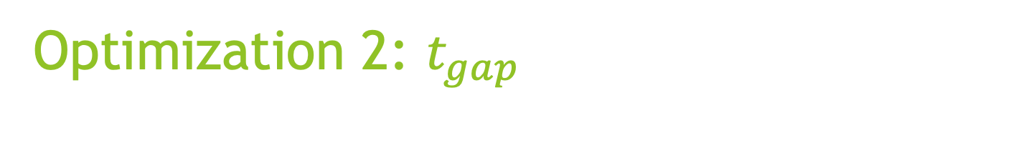
Optimization 2: $t_{gap}$
Problem: when stable-alluip doesn’t learn a shorter clause, the extra cost of resolution could hurt the solver’s performance
Observation: for a 1-UIP clause $C_{1}$, the maximum clause size reduction is bounded by $gap(C1)=|C_{1}|−LBD(C_{1}).$When $gap(C_{1})$is small, stable-alluip is unlikely to succeed
Solution: dynamically set a non-negative target threshold${ t}_{gap}$, such that we do not attempt stable-alluip when $gap(C1) ≤t_{gap}$
$t_{gap}$ is updated on every restart. If the success rate since the last restart is larger than 80% (less than 80%), we decrease(increase) $t_{gap}$ by one not allowing it to become negative

Slide 28
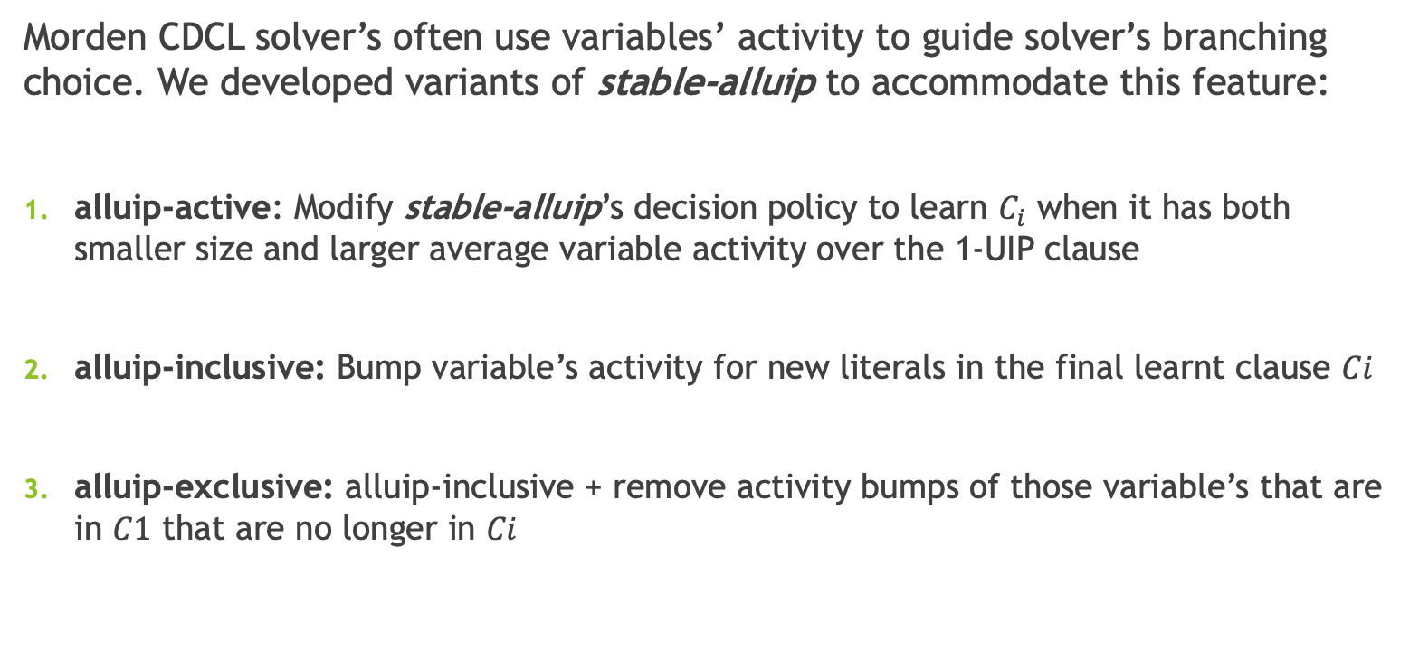
Variants of stble-alluip to Adjust Variable Activity
Morden CDCL solver’s often use variables’ activity to guide solver’s branching choice. We developed variants of stable-alluip to accommodate this feature:
alluip-active: Modify stable-alluip’s decision policy to learn $C_{i}$ when it has both smaller size and larger average variable activity over the 1-UIP clause
alluip-inclusive: Bump variable’s activity for new literals in the final learnt clause $Ci$
alluip-exclusive: alluip-inclusive + remove activity bumps of those variable’s that are in $C1$ that are no longer in $Ci$

Slide 29
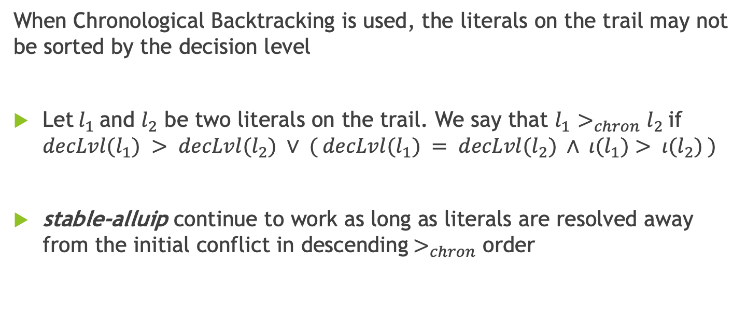
stable-alluip with Chronological Backtracking
When Chronological Backtracking is used, the literals on the trail may not be sorted by the decision level
Let$l_{1}$and $l_{2}$ be two literals on the trail. We say that $l_{1}$ $>_{chron}l_{2}$if $decLvl(l_{1}) > decLvl(l_{2}) ∨ ( decLvl(l_{1}) = decLvl(l_{2}) ∧ ι(l_{1})> ι(l_{2}) )$
stable-alluip continue to work as long as literals are resolved away from the initial conflict in descending${ >}_{chron}$ order

Slide 30

Experiments and Results

Slide 31
Experiment Setup
Base Solver: MapleCOMSPS-LRB
Benchmark: 2019 SAT Race main track
Hardware and limits: 2.70 GHz XeonE5-2680 CPUs with 5000 second timeout and a maximum of 12 GB memory Evaluate the performance of stable-alluip against the baseline 1-UIP

Slide 32
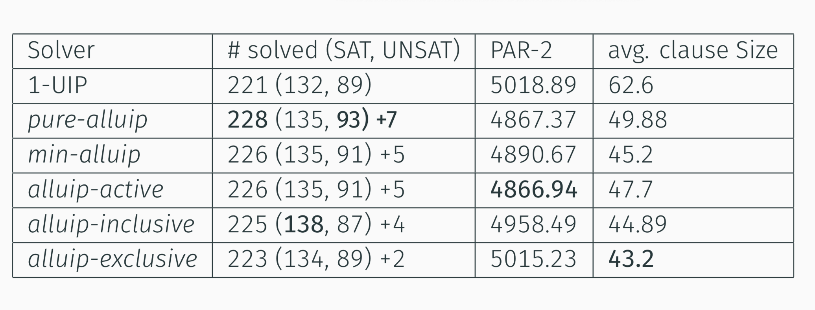

Slide 33
The X and Y axes show the clause length from stable-alluip and 1-UIP, respectively. Each green (red) dot represents an compared instance between 1-UIP and min-alluip (pure-alluip).
Greater reduction for instances with larger 1-UIP clauses

Slide 34
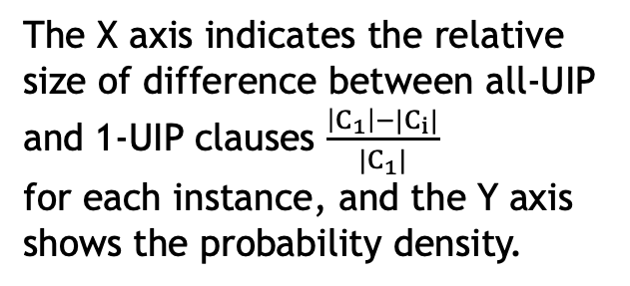
The X axis indicates the relative size of difference between all-UIP and 1-UIP clauses $\frac{\left|C_{1}\right|−|C_{i}|}{|C_{1}|}$
for each instance, and the Y axis shows the probability density.
min-alluip (pure-alluip) produces shorter clauses for 88.5% (77.7%) of instances.

Slide 35
Experiment stable-alluip with Modern Solvers
How does stable-alluip perform in more modern solvers?
We implement stable-alluip in the winner of 2017, 2018 and 2019 SAT race, and in the expMaple-CM-GCBumpOnlyLRB and CaDiCaL solver (5 solvers)
Compare 1-UIP with pure-alluip, min-alluip and the top two variants, alluip-active and alluip-inclusive (4 alluip learning schemes)
We observe similar performance gain and clause reductions in the modern solvers as in MapleCOMSPS-LRB:
In average, around +4 solved instances and 40% average clause size reduction

Slide 36
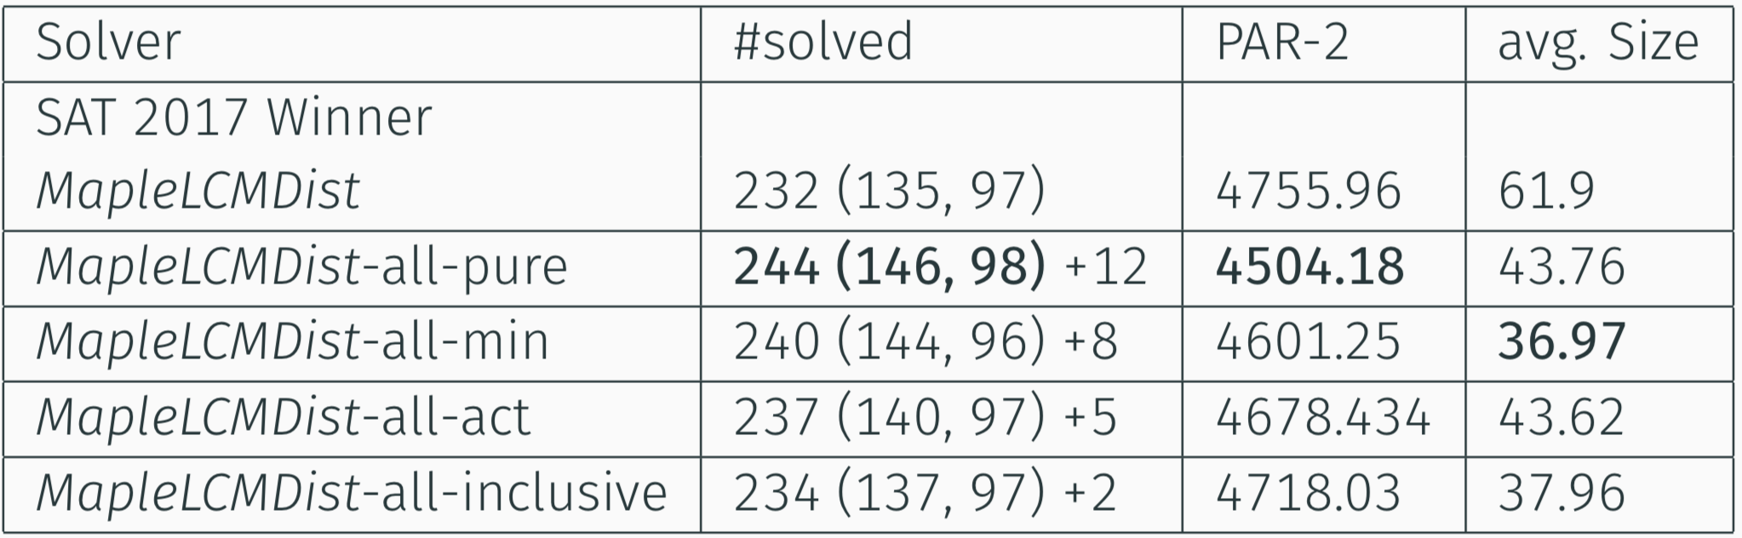
Results on MapleLCMDist (2017 Winner)

Slide 37
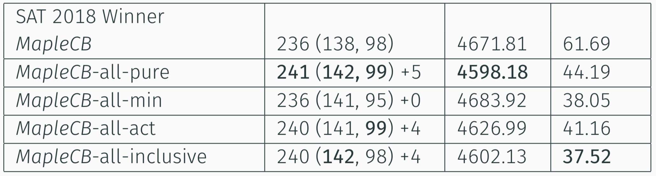
Results on Maple_lcm_dist_chronobt (2018 Winner)
Enabled stable-alluip Chronological backtracking

Slide 38
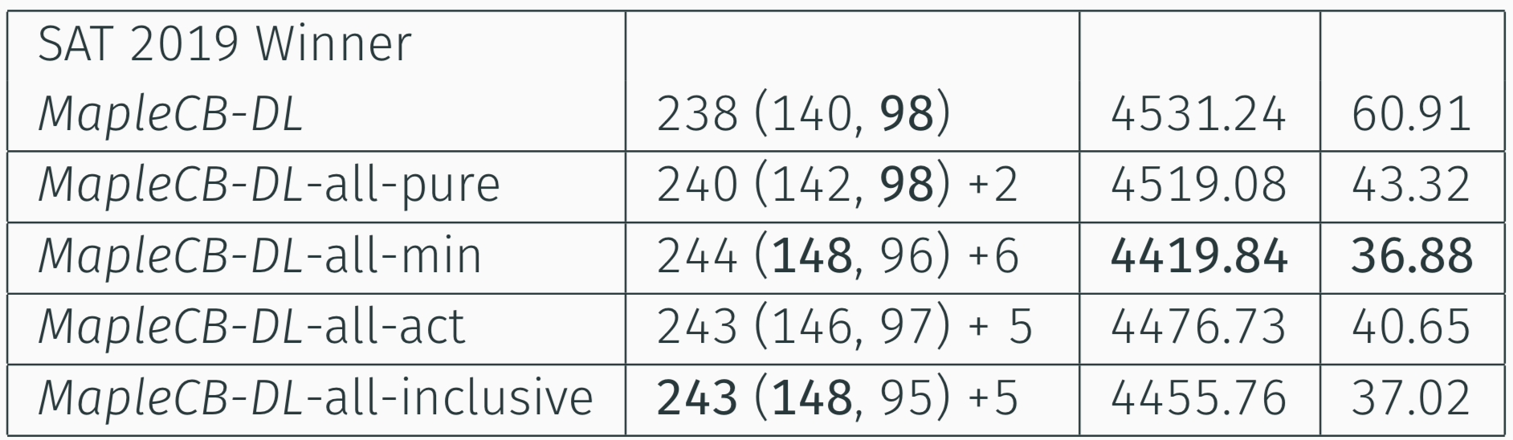
Results on Maple_lcm_distchronobt-dl-v3 (2019 Winner)

Slide 39
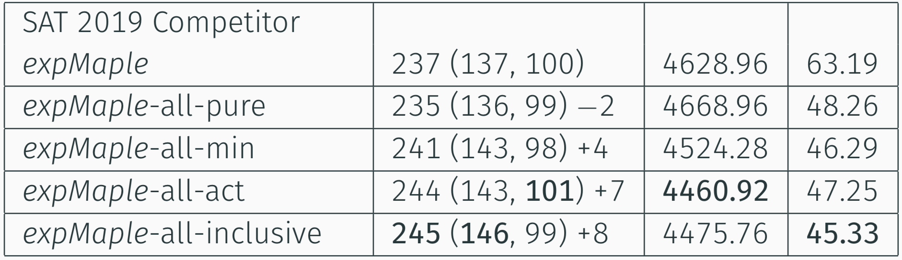
Results on expMaple_CM_GCBumpOnlyLRB (2019 Competitor)

Slide 40
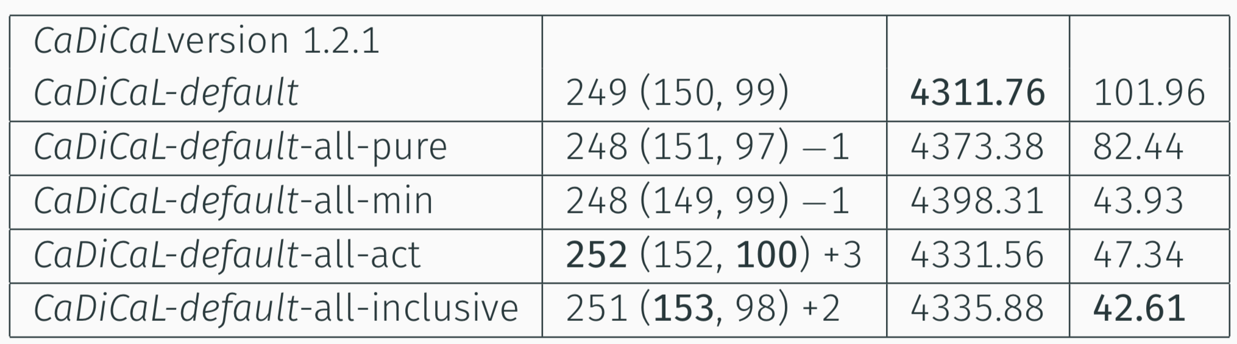
Results on CaDiCaL 1.2.1
CaDiCal (2019 race version) solved 244 instances in the competition

Slide 41

Summary

Slide 42
Through our Work:
Re-examined previously proposed resolution learning scheme through the lens of LBD
designed a novel learning scheme that reduce learnt clause size and maintain the minimum LBD
experimented with the novel learning scheme and provide empirical evidence on its clause reduction power and performance gain
We see opportunity in designing better clause learning schemes to improve SAT solving. The modern solvers have evolved with new features, and the clause learning may want to catch up

Slide 43

Questions?

Slide 44

Backup Slides

Slide 45
Clause Learning Landscape
Most of CDCL Solvers use these
Trivial resolutions
Vivification
SDCL

Slide 46
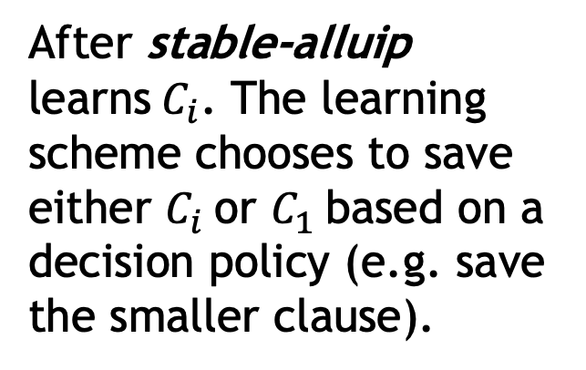
stable-alluip Decision Policy
After stable-alluip learns${ C}_{i}$. The learning scheme chooses to save either $C_{i}$or $C_{1}$based on a decision policy (e.g. save the smaller clause).

